Slide 1
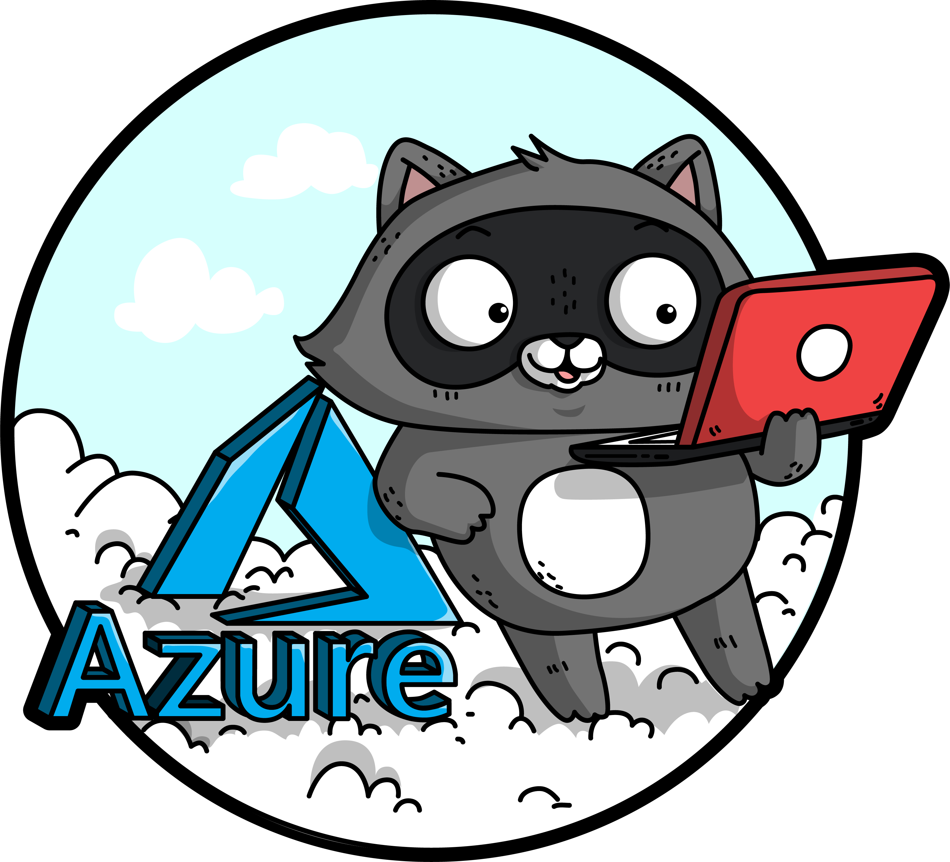
Migration Journey
Sarah Lean

Slide 2
Why migrate?
Notes:
Lots of organisations are asking why move away from traditional on prem datacentres to azure, but there are certain triggers that are driving those decisions.

Slide 3
Software and hardware refresh
Security threats
Urgent capacity needs
Compliance
Quickly integrate acquisitions
Application innovation
Migration & modernization triggers
Software end of support
Datacenter contracts expiry

Slide 4
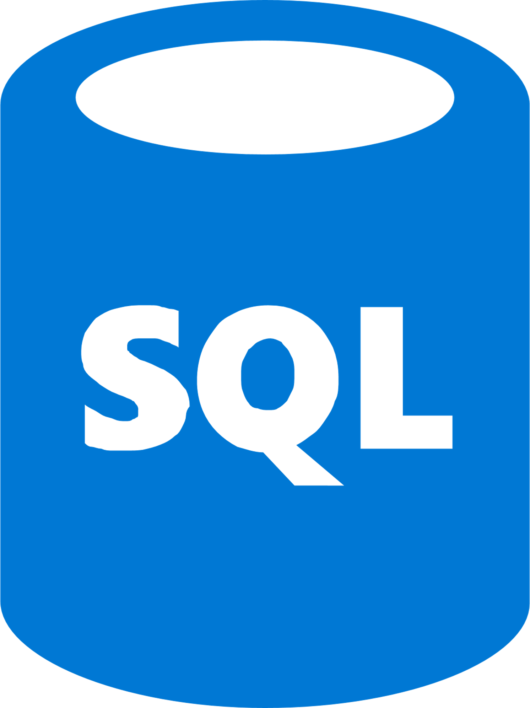
Azure is the best destination for Windows Server and SQL Server
Unique hybrid experiences: Server + Azure
Unparalleled consistency & innovation: Azure SQL Database Managed Instance
Deep trust with
enterprises
Azure Security Center + built-in OS security
Windows Admin Center
Integrated backup, disaster recovery, & identity
Full parity with 100% code consistency
Unmatched support & backward compatibility
Machine learning-based performance & security
More certifications than other providers
Single vendor support
Reuse familiar skills and toolsets

Slide 5





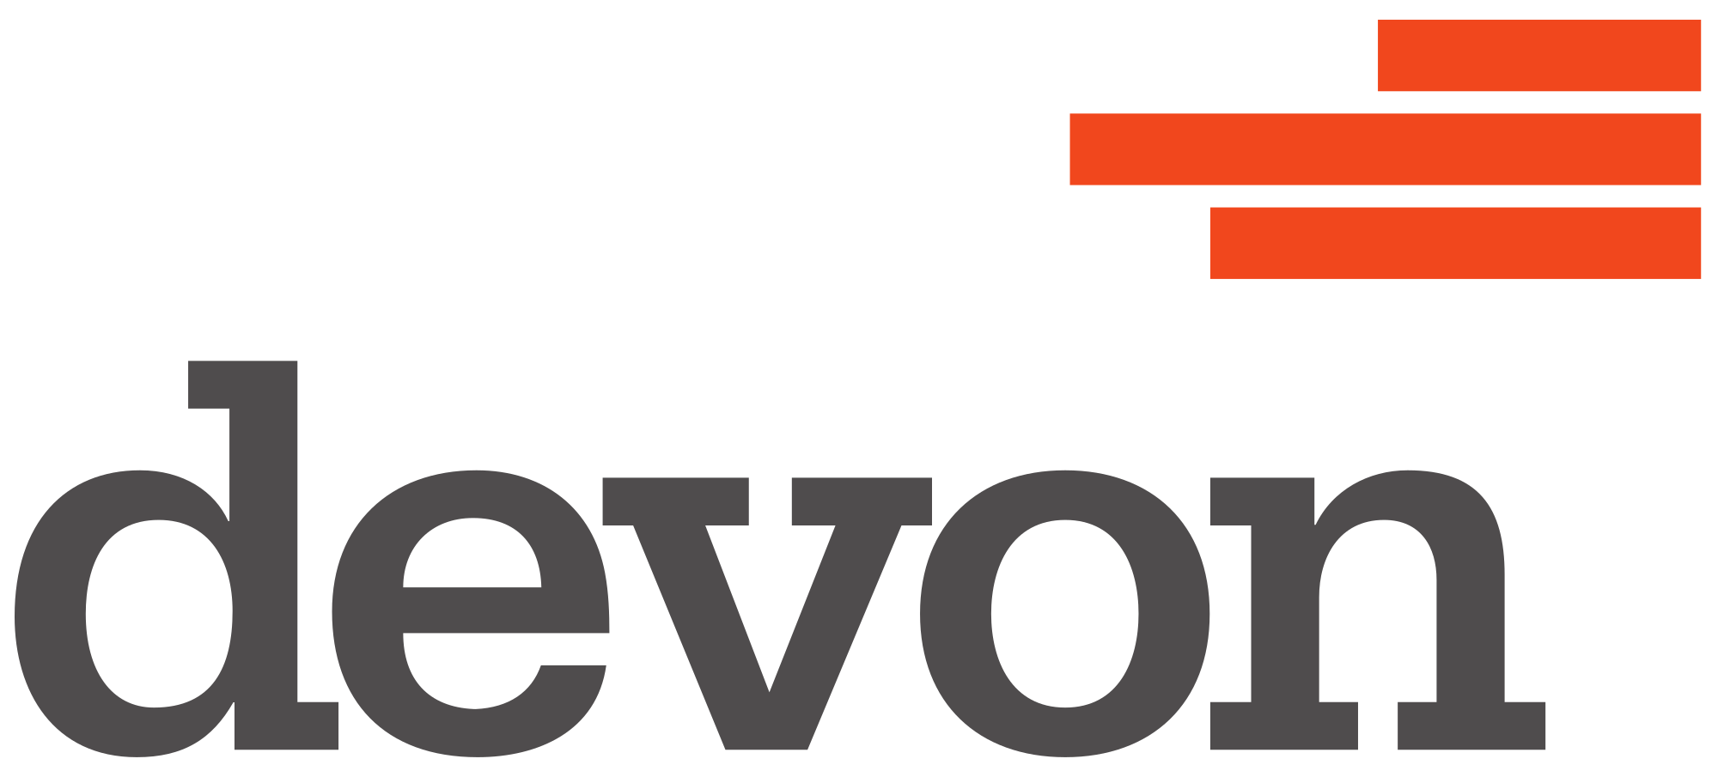
Customer momentum
"Azure Site Recovery has helped us migrate several hundred business critical workloads—including Linux, MySQL, Windows, SQL Server, in a weekend—more quickly, reliably, and securely than we could ever before."
“Azure Database Migration Service was a life saver…we successfully migrated over 100 databases to Azure using the service over two months without any downtime or loss of data.”
“We were able to migrate and modernize several critical Linux, Windows and Java applications to Azure while continuing to run on-premises operations, thanks to Azure hybrid capabilities.”
“We were able to deploy our TimeXtender solution into production on Azure SQL Database Managed Instance in a matter of weeks. We immediately realized a 49% cost savings…..”
“We used SQL Database Managed Instance, a way to migrate huge databases into Azure cloud without changing any code, and stay compliant with all the applications so we can make a one-to-one transfer. ”
“For our cloud journey, we were looking to engage in an emphatic relationship….and Microsoft was the only partner who was prepared to walk side by side with us. ” – Ben Williams, CIO, Devon Energy

Slide 6
The journey
Notes:
There are four stages to this journey, assess, migrate, optimise and secure & manage.
The first two are static stages and one of exercises, the next two are continuous.

Slide 7
Unified and extensible Azure migration experience
Assess
Migrate
Optimize
Secure and manage
Migration tools | Azure migration center | Scenario guidance | FastTrack for Azure | Azure Expert MSPs
Azure Fundamentals
Target architecture | Governance | Connectivity | Security | Training & Readiness

Slide 8





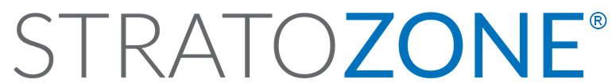


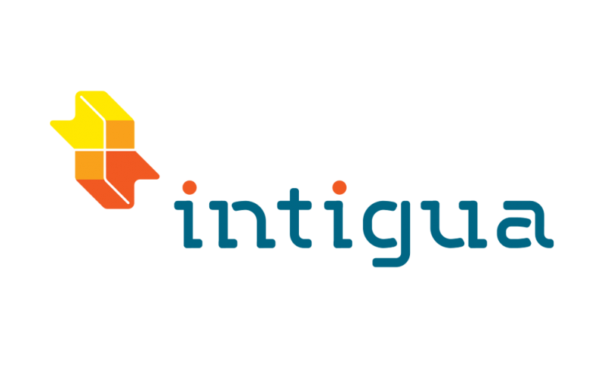







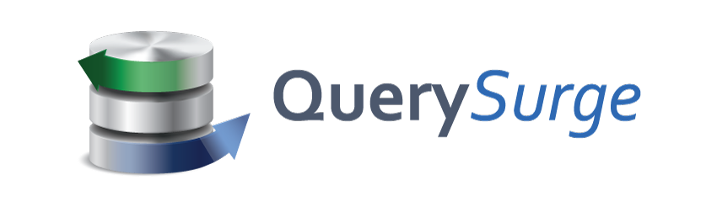
Choice of tools for every stage and every requirement
Goal is successful Azure migration: Pick the right tool for the job
Assess
Migrate
Optimize
Secure & Manage
Azure Migrate
Azure Site Recovery (ASR)
Azure Cost Management
Azure Advisor
Azure Security & Management
(e.g., Blueprints, Security Center, Backup, Monitor)
Data Migration Assistant (DMA)
Azure Database Migration Service
SQL Server Migration Assistant (SSMA)
Azure Data Box
We embrace ISV solutions

Slide 9
Assess

Slide 10
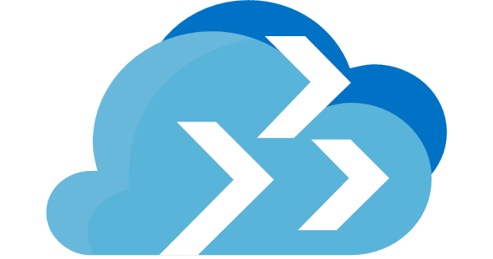
Assess your environments with Azure Migrate
App performance history
App configuration data
Applicable discounts and offers
(e.g., Azure Hybrid Benefit, RI)
Target Azure location
Azure suitability analysis
(e.g., compatibility)
Rightsized Azure resource model
Azure cost estimates
App dependency map
Azure Migrate
VMware assessments | Windows and Linux assessments | Free, built in service

Slide 11
Appliance-based
No pre-setting or pre-configuring a machine
No installation of pre-requisite software

Slide 12
Data Collected
Cores
Memory
Disks
Disk Sizes
Network Adapters
CPU usage
Memory usage
Disk IOPS
Disk throughput (MBps)
Network output (MBps)
VM Name
IP Address

Slide 13
Dependency Mapping
Agent based – two agents need to be installed on each server
The agents send information direct to Azure via the Internet
Presents a view of your servers as you think of them – as interconnected systems
Discovers and maps server and process dependencies in real-time

Slide 14
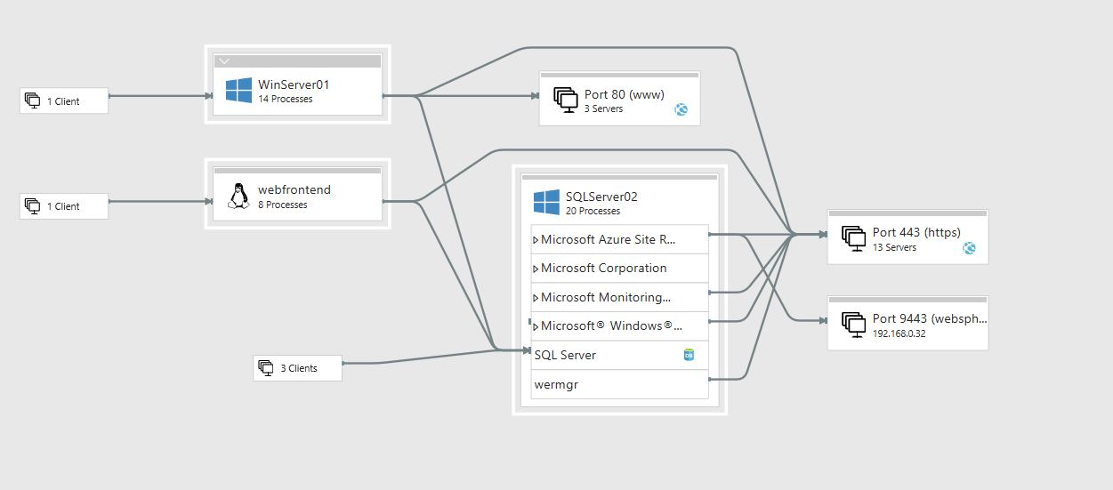
Dependency Mapping Example
Notes:
This example is showing what happens when the agent is installed on three servers and the level of detail we get visually.

Slide 15
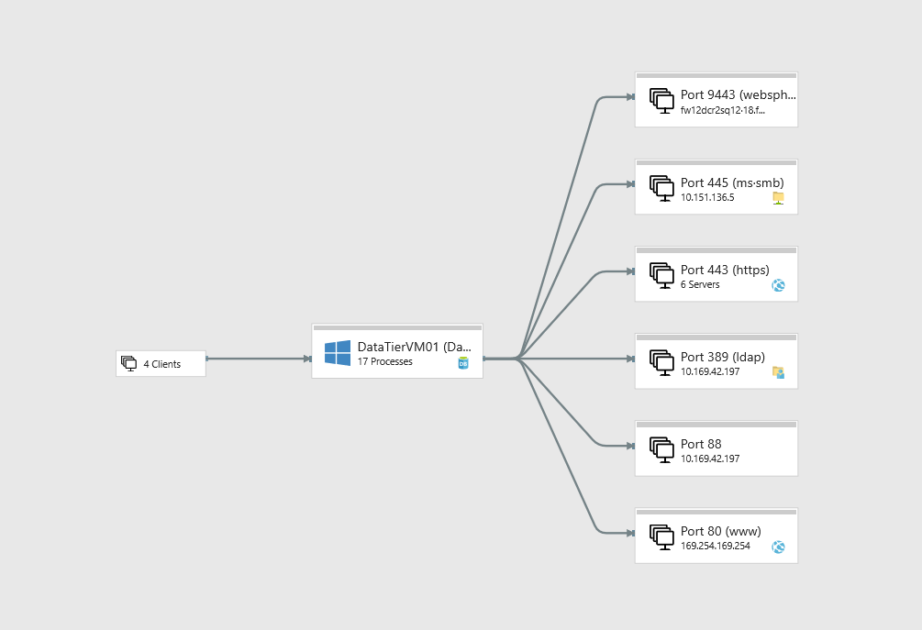
Dependency Mapping Example
Notes:
This example shows you what view you get if only one server has the agent installed.
The level of information is high level for the other servers.

Slide 16
Information Gathering
Once the tooling has collected information interviews/surveys of the business and applications owners need to be undertaken
This human information gathering helps to decipher what information we’ve gathered via the tooling and fill in the gaps

Slide 17
Migrate

Slide 18
Migration Strategy
Rehost
Refactor
Rearchitect
Rebuild
Description
Redeploy as-is to cloud
Minimally alter to take better advantage of cloud
Materially alter/decompose application to services
New code written with cloud native approach
Drivers
Faster, shorter, updates
Code portability
Greater cloud efficiency (resources, speed, cost)
App scale and agility
Easier adoption of new cloud capabilities
Mix technology stacks
Accelerate innovation
Build apps faster
Reduce operational cost
Reduce Capex
Free up datacenter space
Quick cloud ROI
Technologies
IaaS
Containers
PaaS
PaaS
Serverless
Microservices
Notes:
Now you have the information you need to decide the migration strategy

Slide 19
Rehost Tooling
Need to understand the correct tooling to help migrate the workloads
For a rehost potentially Azure Site Recovery and/or Azure Database Migration Service
Third party tooling is also available

Slide 20
Foundational best practices for Azure migration
People
Planning & process
Technology
Drive org culture change
Set up migration center of excellence (CoE)
Ensure right stakeholders are engaged
Provide learning paths & certifications
Use skilled migration partners
Build biz case w/ exec sponsorship
Plan migration strategies
Start small: Do a pilot
Track migration scorecard
Track and optimize cloud spends
Choose the right tools for the job
Govern Azure environments & resources
Extend networking/identity to Azure
Establish robust security foundation
Use integrated security/management tools

Slide 21
Optimise

Slide 22
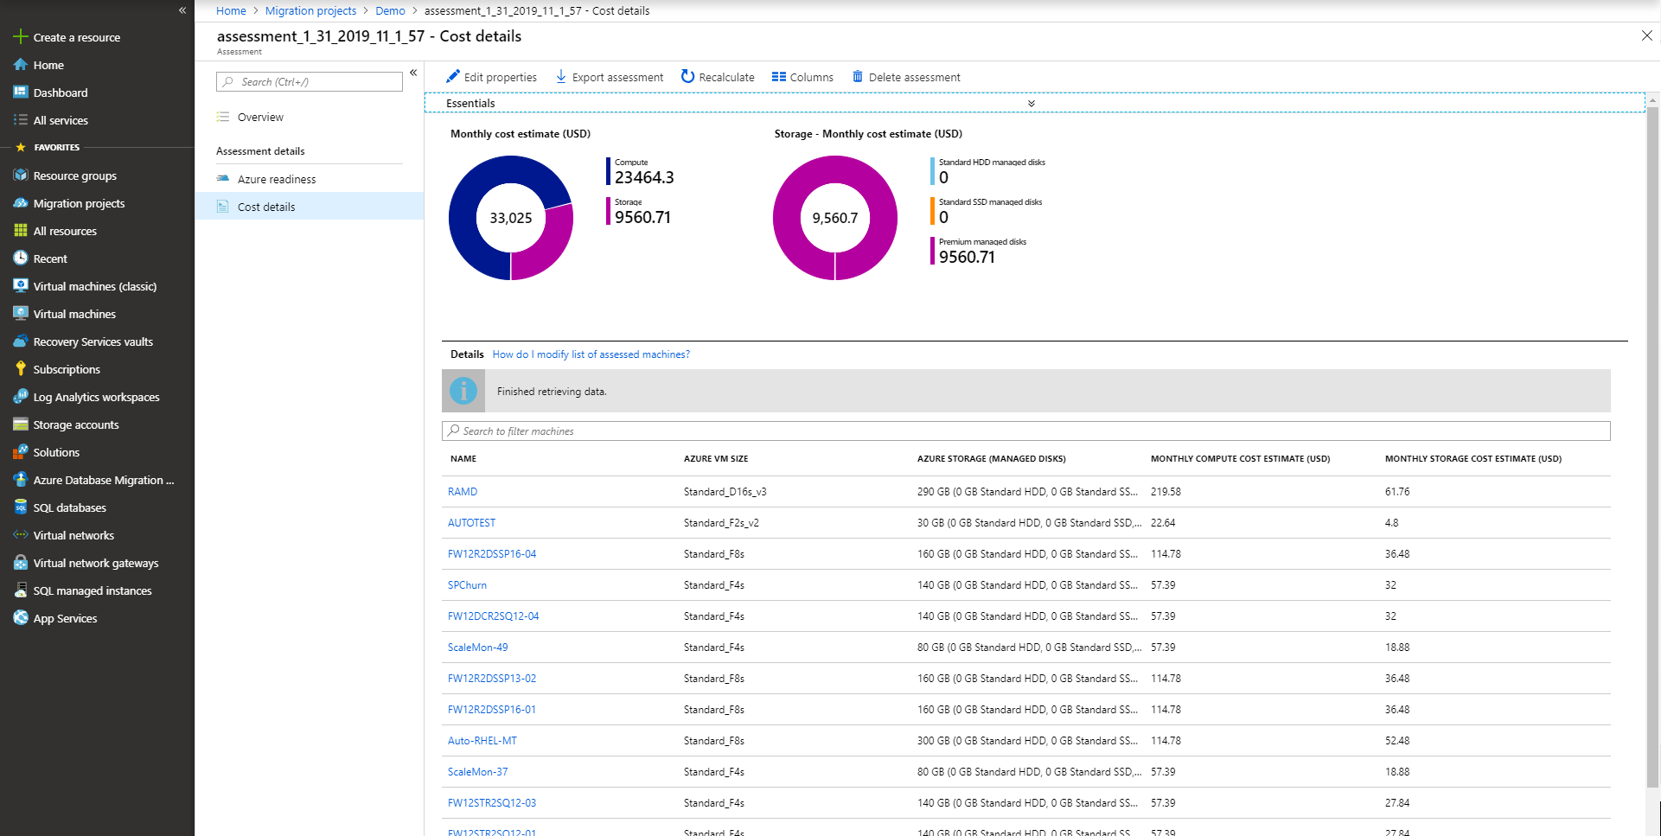
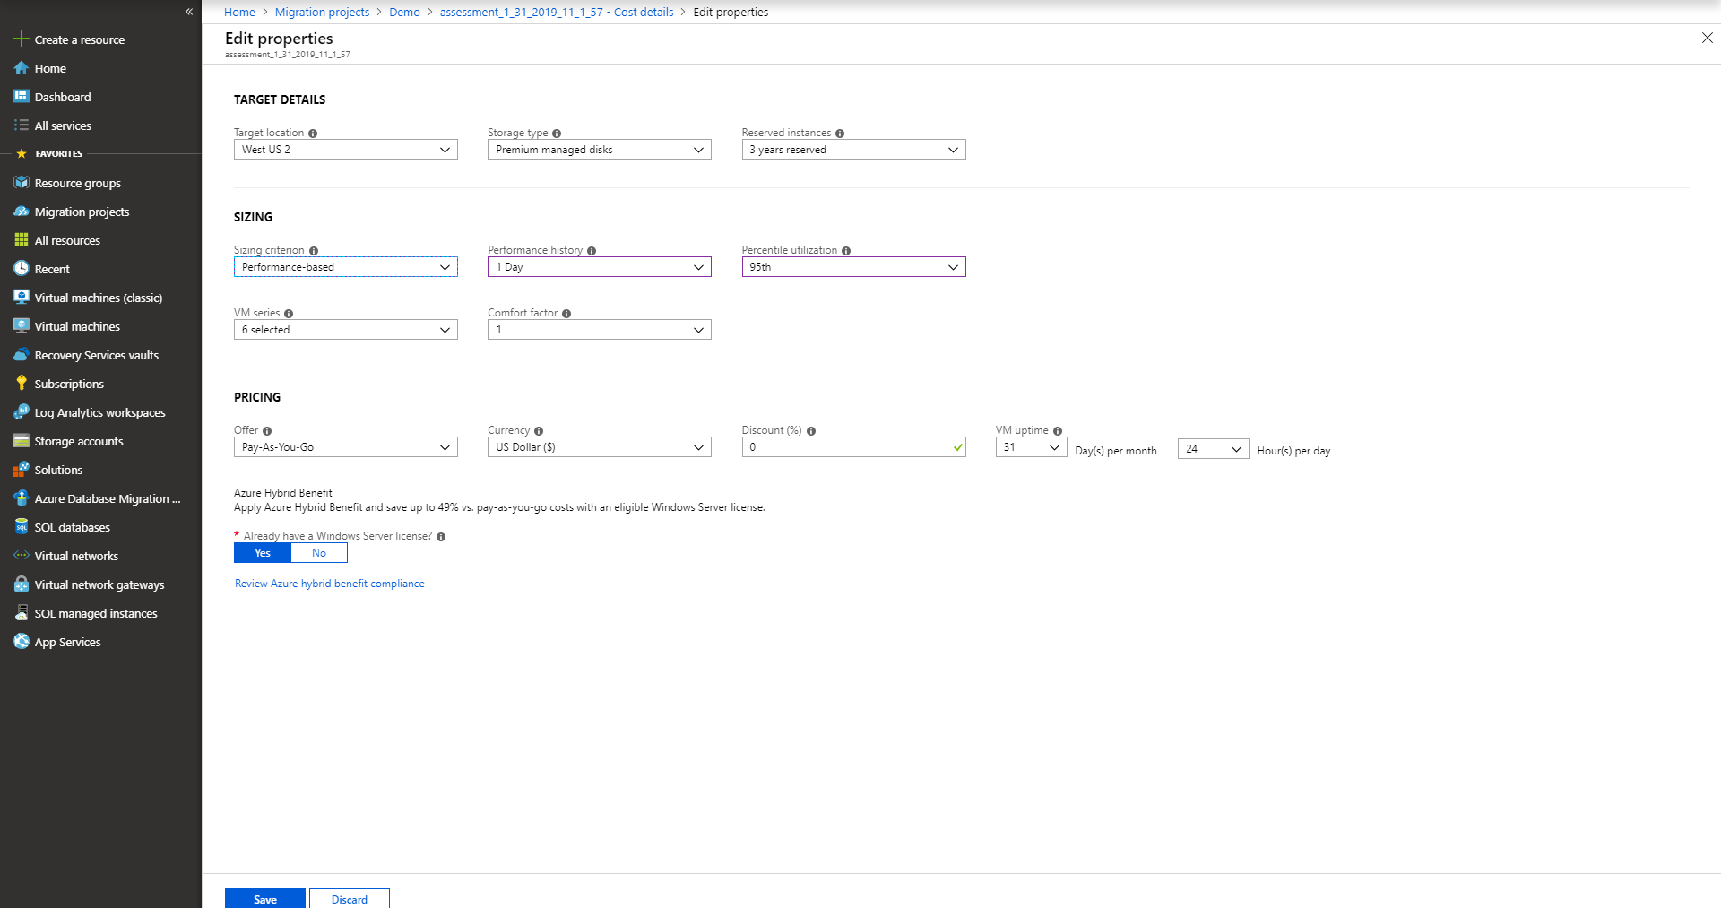

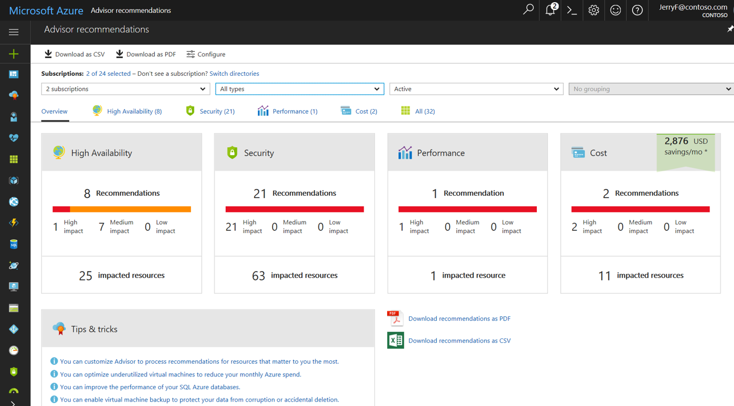
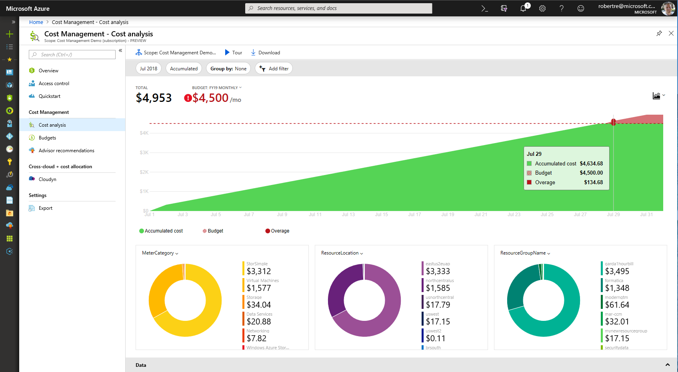
Continuously optimize resources during and after migration
As you move
Right-size Azure resources based on assessment guidance
Use Azure Hybrid Benefit and Azure Reserved Instances to save money
After you move
Unified experience to optimize cloud spends: Azure Cost Management
Azure Advisor: Built-in best practice recommendations
(e.g., turn off idle VMs)
Modernize for longer term value

Slide 23
Secure & Manage

Slide 24


Keep migrated workloads secure and managed
Built-in, intelligent services for Azure and on-premises workloads
Governance
Security
Resiliency
Monitoring
Automate
Proactively apply policies and optimize cloud spend
Industry leading Security with Advanced Threat Protection
High availability and protection for VMs, apps and data
Deep operational insights with rich intelligence
Powerful scripting, configuration and update management
Turn on security, backup, and monitoring for every migrated resource

Slide 25
Best practices by phase
Learnings from at-scale Azure migrations
Assess
Migrate
Optimize
Secure & Manage
Build an Inventory of apps, databases, & VMs
Update or create service catalog with the Business, and beware departmental apps, databases & reports
Look for good POC candidates
Assign priority, complexity & risk to all items which will be migrated to Azure
Beware of higher security apps and those which integrate with firewalls
“Redesign” every app for Azure!
Choose the right tool for the job, and be flexible
Select more powerful sizes of Azure resources during the migration and scale down (saves time during migrations)
Involve the Business at every step, identify a contact for each group and demand testers and sign-off (no Monday madness)
Perform non-disruptive testing and performance testing prior to cutovers
Start with Easy, then move on to the hard
Azure Cost Management is a critical tool
Leverage Azure Hybrid Use Benefit for Windows and SQL along with Reserved Instances to save up to 80%
Scripts and Azure Automation should be used to shutdown VMs that aren’t needed 24x7
Watch out for migration left overs like onetime backups sitting in Blob Storage or VHDs and Snapshots that aren’t being used
Migration isn’t complete until it is fully operatized with monitoring, backup, failover and security configured
Partner solutions can be extended to the cloud if you use a third-party backup, it will most likely work with Azure
Leverage Azure Automation or tools like Terraform, Chef & Ansible
Leverage Platform tools such as Azure Security Center, Log Analytics and Application Insights

Slide 26
Q&A

Slide 27
Thank You.

